Slide 1

Molecular dynamics study of the binding between SARS-CoV-2 spike protein and human ACE2 and the effects of key mutations on the viral-host interaction
Kulisara Kittivibul (639951001)
Seminar in Biotechnology
Interdisciplinary Program in Biotechnology, Graduate School,
Chiang Mai University, Semester 1 | Academic year 2021
Notes:
Good morning, ladies and gentlemen, my name is kulisara kittivibul. Today I would like to talk about my work on Molecular dynamics study of binding between SARS-CoV-2 spike protein and human ACE2 and effects of key mutations on the viral-host interaction.

Slide 2
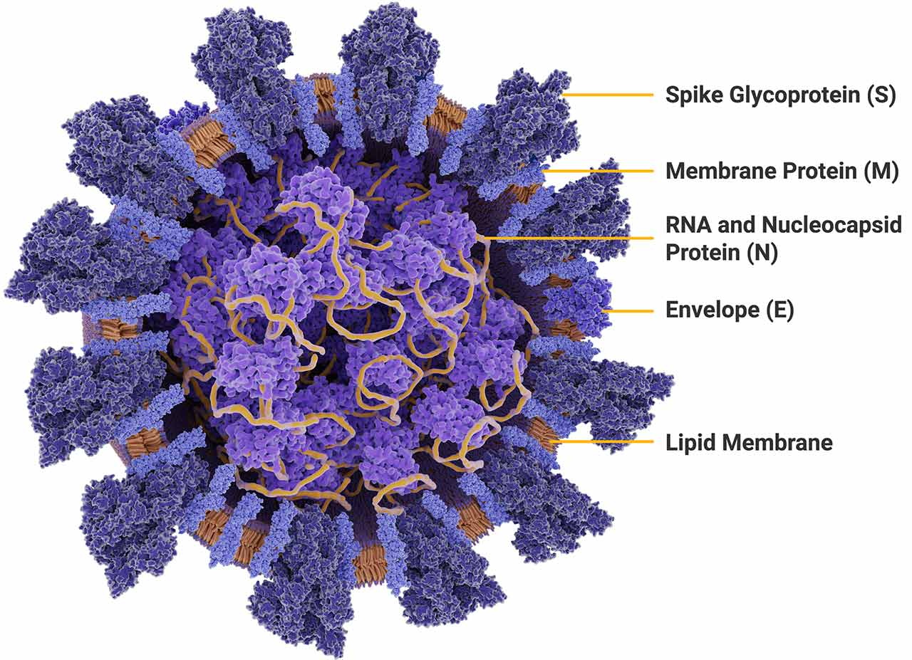
Severe Acute Respiratory Coronavirus 2 (SARS-CoV-2)
SARS-CoV-2 is a causative pathogen of coronavirus disease 2019 (COVID-19).
It was first identified in Dec 2019 in Wuhan, China.
The virus belongs to betacoronavirus genus. It has a large and rough spherical envelope (100-120 nm), which contains linear positive-sense single-stranded RNA (+ssRNA) (ca. 30 kb).
SARS-CoV-2 has four structural proteins: envelope (E), spike glycoprotein (S), membrane (M), and nucleocapsid (N).
(Gorbalenya et al., 2020; Zheng, 2020; P. Zhou et al., 2020)
Notes:
Let’s start with SARS-CoV-2.

Slide 3
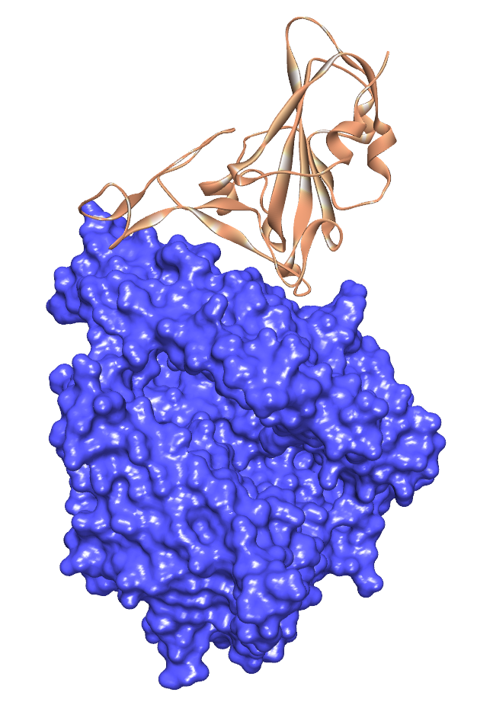
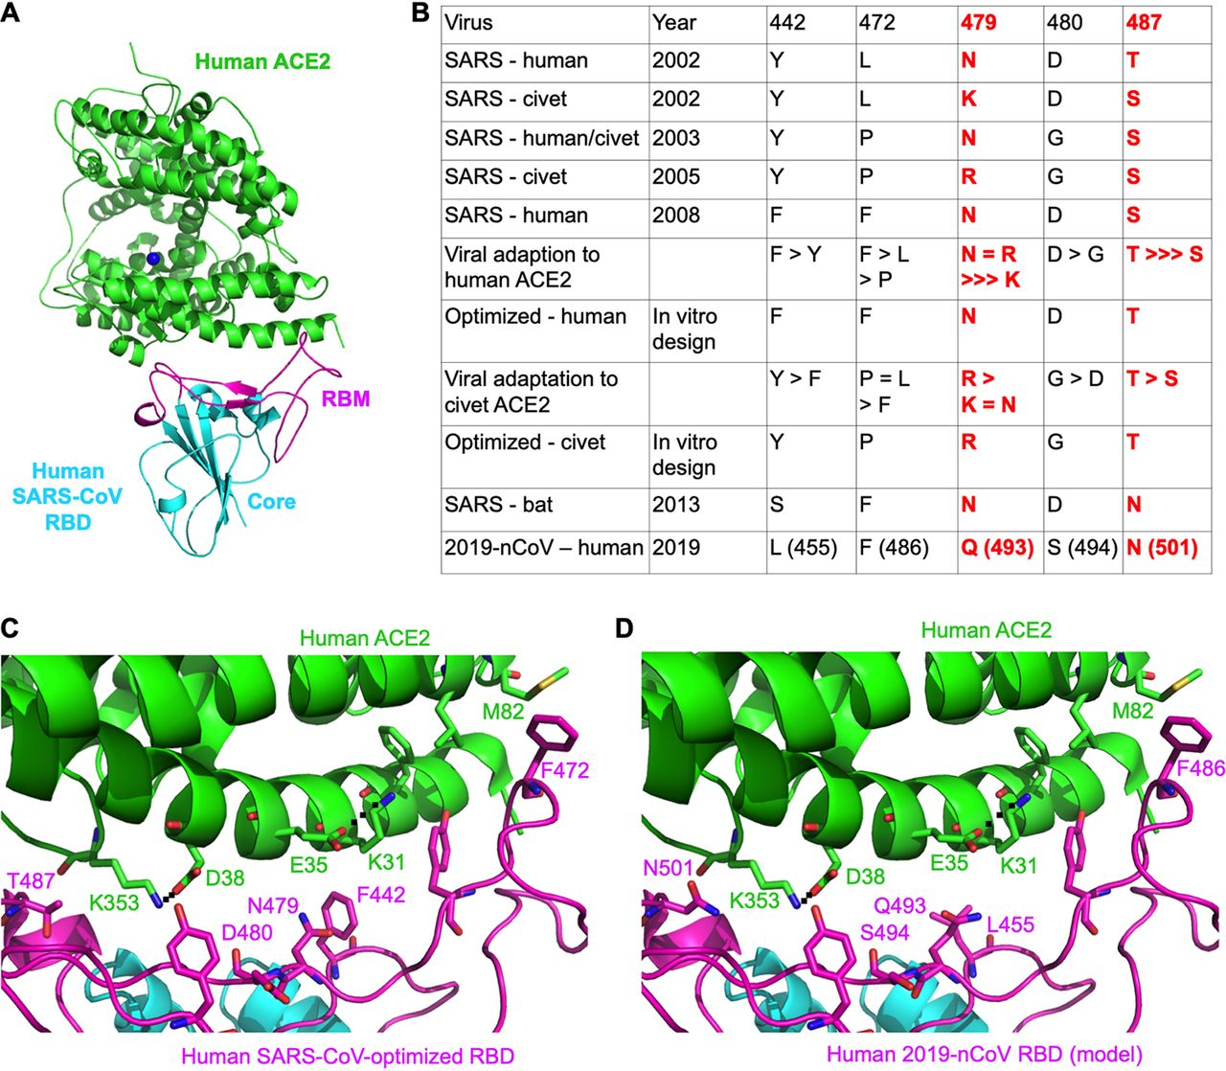
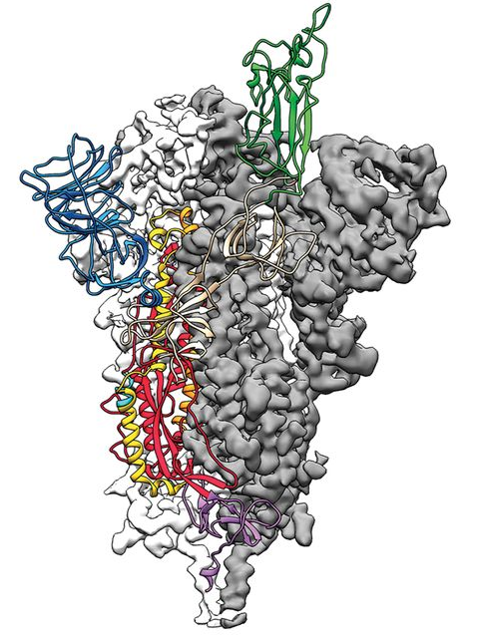
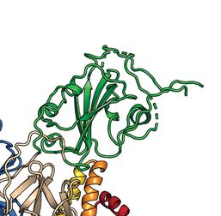
SARS-CoV-2 Spike Glycoprotein Receptor Binding Domain (RBD)
PDB ID: 6M0J
SARS-CoV-2 RBD
RBD
(Receptor binding domain)
Wrapp et al., Science 367, 1260–1263 (2020)
Angiotensin Converting Enzyme 2
The SARS-CoV-2 S protein is highly conserved among all human coronaviruses (HCoVs) and is involved in receptor recognition, viral attachment, and entry into host cells.
The receptor-binding domain (RBD, 319–541 residues) is located in the S1 subunit of the spike protein.
The RBD region attaches to ACE2 receptor on human cell surface, mediating membrane fusion and viral entry mechanism.
(Gross et al., 2020; Lan et al., 2020; Wrapp et al., 2020)
Notes:
Surface location of the spike glycoprotein is a direct target for host immune responses, neutralizing antibodies, and become one of the most important targets for COVID-19 vaccine and therapeutic research.

Slide 4
Examples of SARS-CoV-2 Variants with T478K, E484K, and S477N Mutation on RBD
WHO label | PANGO lineage | WHO classification | Amino acid substitution
 |  |  | T478K | E484K | S477N
Beta | B.1.351 | Variant of Concern | - | + | -
Gamma | P.1 | Variant of Concern | - | + | -
Delta | B.1.617.2 | Variant of Concern | + | - | -
Mu | B.1.621 | Variant of Interest | - | + | -
- | B.1.1.318 | n/a | - | + | -
- | P.1+P681H | n/a | - | + | -
- | B.1.617.2 (delta) + K417N | n/a | + | - | -
- | C.1.2 | n/a | - | + | -
- | AY.4.2 | n/a | + | - | -
- | B.1.617.2 (delta) + E484K | n/a | + | + | -
Omicron | B.1.1.529 | Variant of Concern | + | + (A) | +
Baj A, Novazzi F, Pasciuta R, Genoni A, Drago Ferrante F, Valli M, et al. Breakthrough infections of E484K-harboring SARS-CoV-2 Delta variant, Lombardy, Italy. Emerg Infect Dis. 2021 Dec [date cited]. https://doi.org/10.3201/eid2712.211792
O’Toole Á, Hill V, Pybus OG et al. (2021), Tracking the international spread of SARS-CoV-2 lineages B.1.1.7 and B.1.351/501Y-V2, Wellcome Open Res DOI:10.12688/wellcomeopenres.16661.1
Notes:
This is an example of an important mutations on the RBD domain of SARS-CoV-2.
E484K contributes to the background in most of SARS-CoV-2 variant of concern and T478K also emerges in delta variants.
But during June-July 2021, there was a delta+E484K mutation appeared in Italy. And in November 2021, there was a new dominant variant called Omicron.

Slide 5

Computational Methods
Molecular Dynamics (MD) Simulations
Molecular Mechanics Poisson-Boltzmann Surface Area (MM/PBSA)
Notes:
Since the virus has spread and mutated very quickly, to study the structural changes in the spike protein, we make use of computational methods. I would like to provide some information about 2 computational approaches that are widely used, which are Molecular Dynamics simulations and Molecular Mechanics calculations.

Slide 6
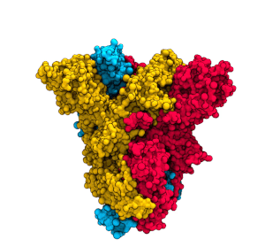
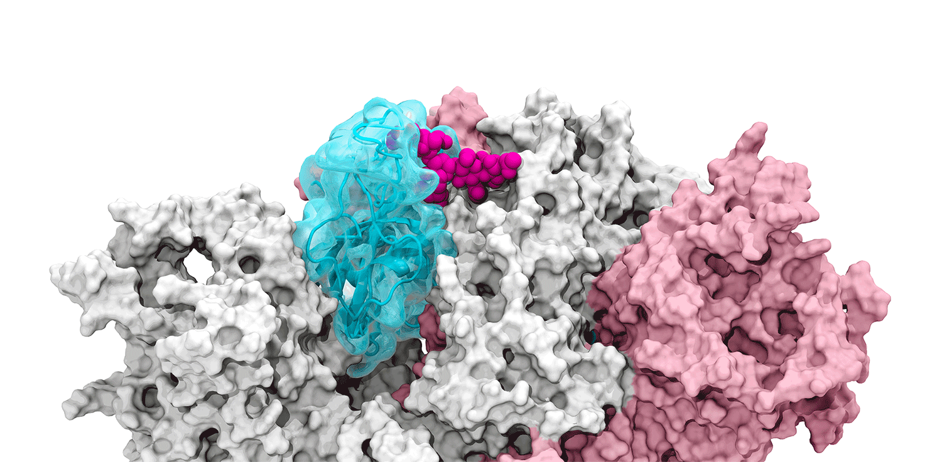
Molecular Dynamics (MD) Simulations
Molecular dynamics (MD) simulation
An important computational tool that allows us to understand physical function and movements or dynamics of biological molecules by simulating several atoms in an in silico system at multitude of timescales.
Molecular dynamics basic algorithm
The glycan gate opens in SARS-CoV-2 spike RBD
Amaro Lab, UC San Diego
SARS-CoV-2 spike protein
https://www.simmerlinglab.org/
Outputs from the MD simulations are trajectories representing snapshots of evolution of the system and appropriate values of time, energy (for example van-der-Waals), applied force, temperature of the system, etc.
(Choi et al., 2018; Hollingsworth & Dror, 2018; Hospital et al., 2015; Muratov et al., 2021)
Notes:
This is the MD simulations algorithm. First, we need to know the potential energy of each atom at the initial position and velocity.
When we know the energy and position, we can calculate force. And when we know the force, we can predict the acceleration as well as the new position and velocity of each atoms in the molecule of interest. This calculation will repeat again and again until the end of the process. So, we will know how the whole system behave over time in some certain conditions. The spatial progression of the MD run showing the pathway of changing atomic positions is called MD trajectory.

Slide 7
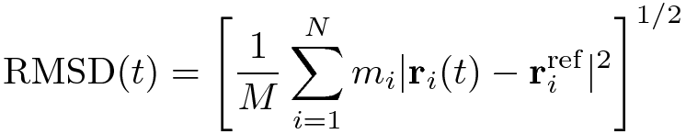
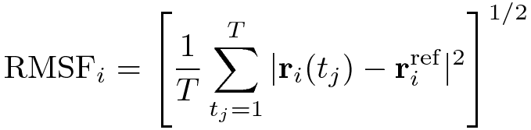
Analysis of MD Simulations
Root-mean-square Deviation (RMSD)
A standard measure of the average distance between a group of atoms (e.g., backbone atoms of a protein) over time from an initial position.
Root-mean-square Fluctuation (RMSF)
A measurement of the average deviation of a particle (e.g., a protein residue) over time from a reference position.
(Fuglebakk et al., 2012; Horx & Geyer, 2020)
Notes:
For MD analysis, there are many analysis methods for MD trajectories, but the most common analysis are RMSD and RMSF.
RMSD is a standard measure of the average distance between backbone atoms of a protein over time from its initial position.
This is the RMSD plot between time (in x axis) and distances of mass (in y axis). These are the movement of the overall protein structure during a time of simulations compared to the initial position.
RMSF is a measurement of the average deviation of each amino acid residue over time from a reference position. It can tell us how flexible of a local structure is from how much that particular residue fluctuates.
This is the RMSF plot between residue (in x axis) and fluctuation (in y axis). These are the deviation of each residue during a time of simulation compared to the initial position.

Slide 8
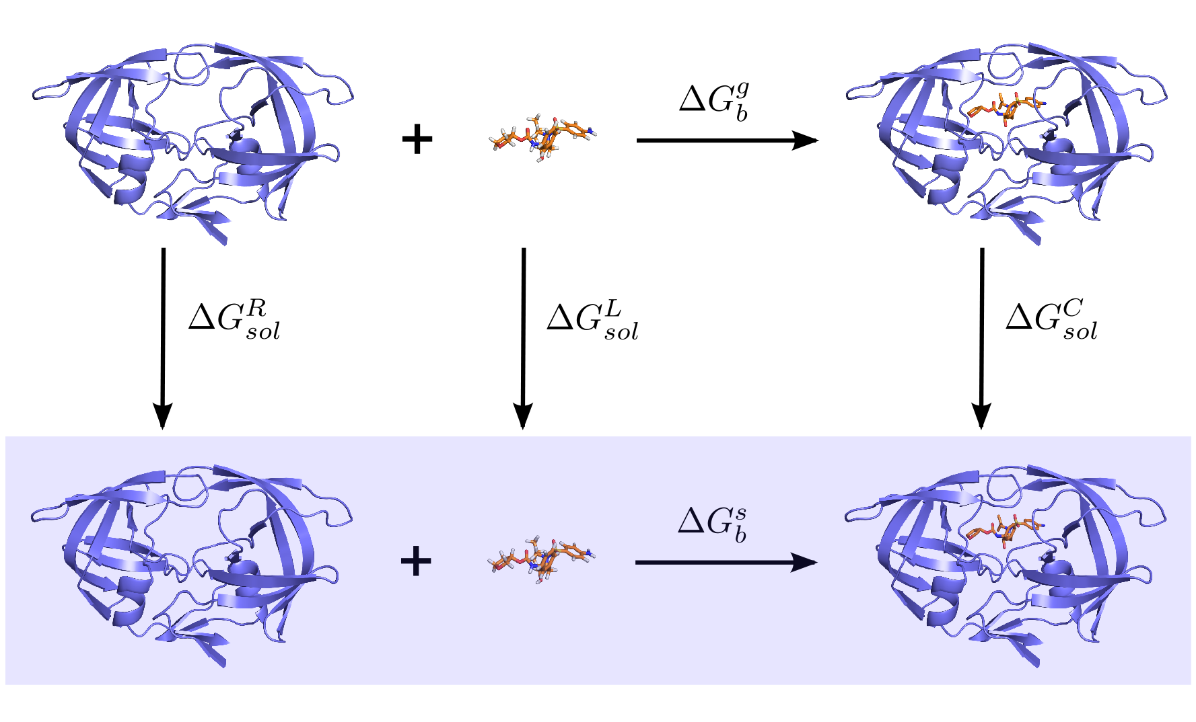
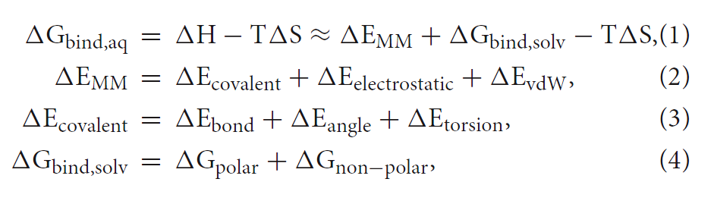
Molecular Mechanics Poisson-Boltzmann Surface Area (MM/PBSA)
The MM/PBSA
(molecular mechanics energies combined with the Poisson–Boltzmann and surface area continuum solvation)
MM/PBSA is used to estimate protein-ligand binding affinity in terms of binding free energy (ΔG_{binding}).
It improves the results of virtual screening and molecular docking.
It was originally defined by Kollman et al. in 2000.
MM/PBSA binding free energy calculation with a thermodynamic cycle
MM/PB-GBSA Equations
Protein
Ligand
Protein-ligand
Vacuum
Solvent
Gas phase
Poisson-Boltzmann (PB) or Generalized-Born (GB) equation
Solvent accessible surface area (SASA)
Solvation
(Amaral et al., 2017; Capriotti et al., 2008; Decherchi & Cavalli, 2020; Genheden & Ryde, 2015; Jost Lopez et al., 2020; Wang et al., 2018)
Notes:
This is the MM/PBSA binding free energy calculation with thermodynamics cycle between protein and ligand in gas phase and solvation environment
This are MM/PBSA equation for binding free energy calculation. The delta G binding can be calculated by the sum of molecular mechanic energy and solvation free energy. And for the solvation free energy, it can be calculated using Poisson-Boltzmann or Generalized-Born equation for polar contribution, and solvent accessible surface area for non-polar solvation.

Slide 9
Research objectives
To examine the interactions between the SARS-CoV-2 spike glycoprotein and hACE2 on the mutation at position 477, 478, and 484.
To predict the impact of the mutations on SARS-CoV-2 RBD toward the hACE2 using computational approaches.
Notes:
For my research objectives

Slide 10
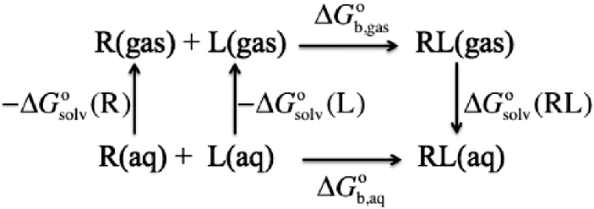
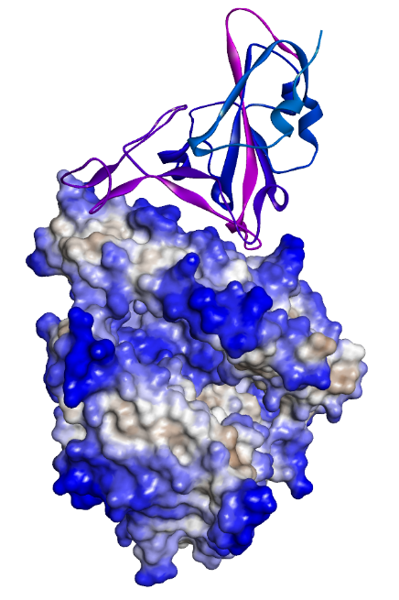
Methods
Homology modelling
Molecular Dynamics simulations
MM-GBSA calculation
Binding free energy (ΔG) calculation
The 3D-structure of SARS-CoV-2 with hACE2 (PDB ID: 6M0J)
SWISS-Model
200 ns of MD simulations
GROMACS 2020
The binding free energy calculation from MM/PB or GBSA
RBD loop 3 region (Residues 472-490)
SARS-CoV-2 spike protein
https://www.simmerlinglab.org/
PDB ID: 6M0J
Jansen, 2015, DOI:10.1039/C5CP00628G
Notes:
For the experimental methodology, we started with the homology modelling. Because not many mutations of spike protein structure have been reported, we have to build the mutated RBD-ACE2 structures by ourselves using SWISS-Model.
We then ran 200 ns of MD simulations using GROMACS software. After that, the MM-GBSA and dG were calculated to estimate the protein binding affinity of each complex.
This one is optional. Perhaps, I will do the feature importance calculation by creating a classifier model or neural network model and using it to predict which feature is important to the model.

Slide 11
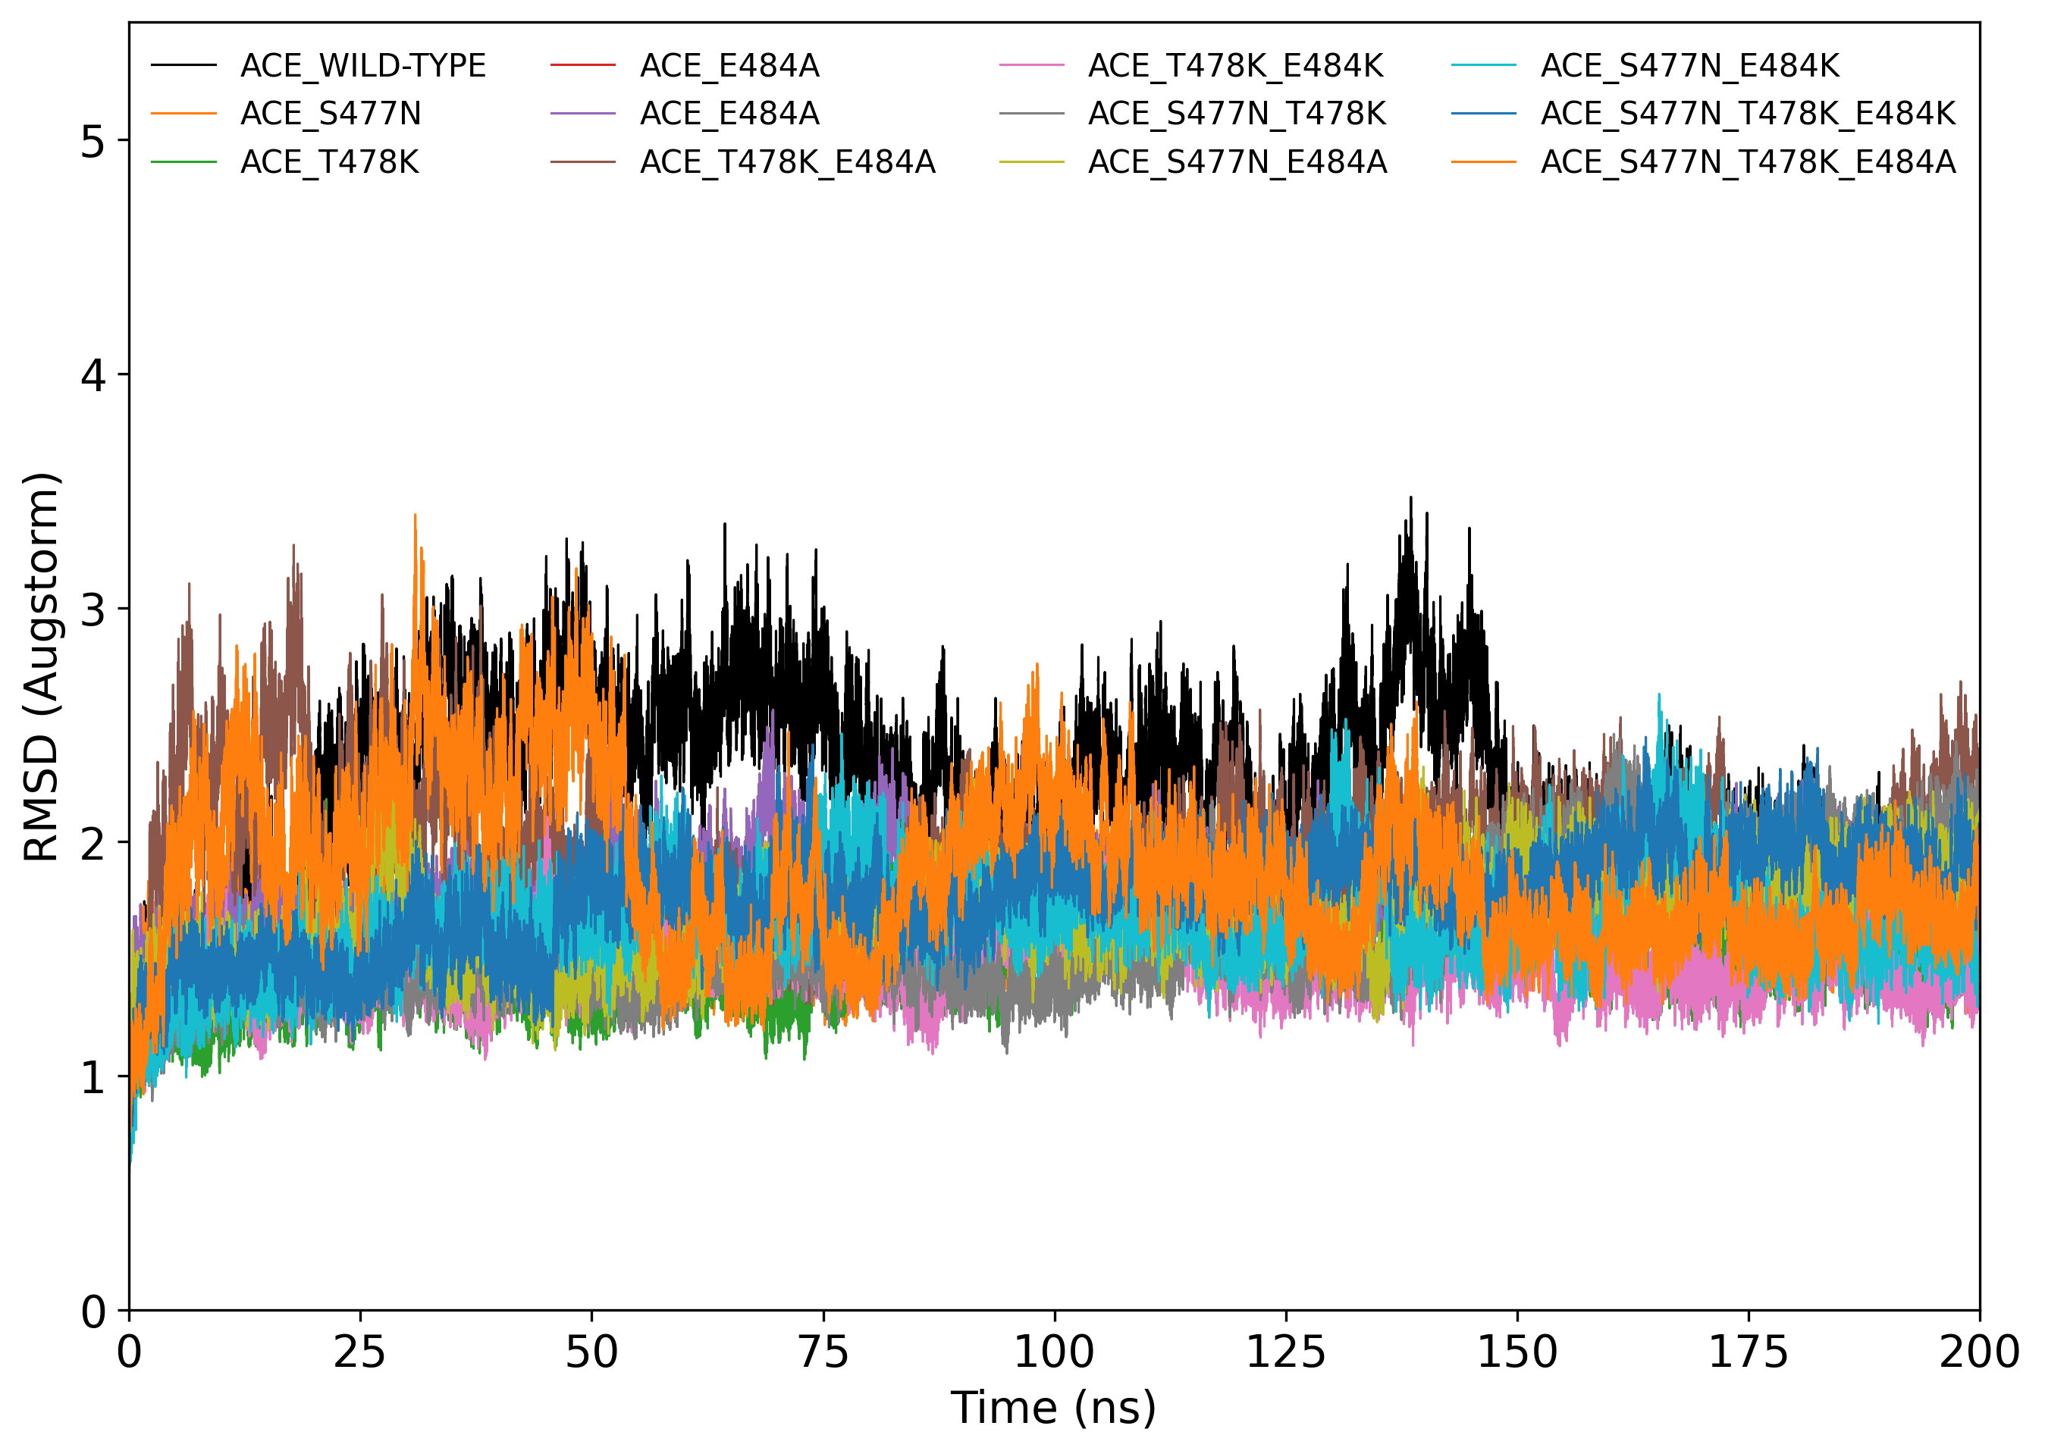
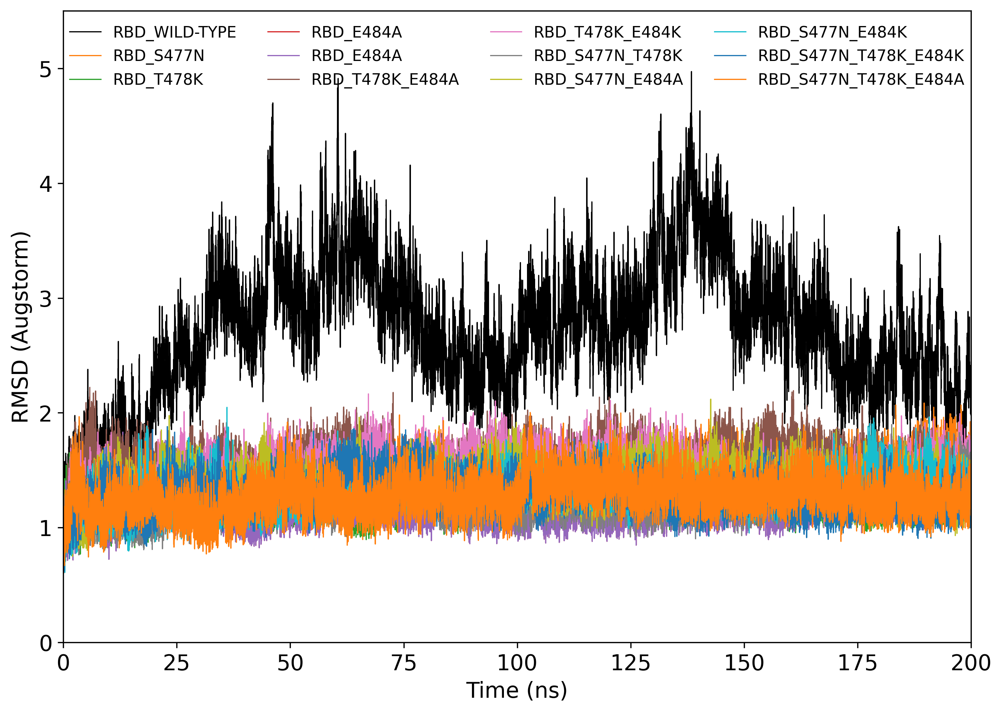
Root-mean-square deviation (RMSD) of hACE2 and SARS-CoV-2 RBD
Root-mean-square deviation (RMSD) of hACE2
Root-mean-square deviation (RMSD) of SARS-CoV-2 RBD
The RMSD plot of hACE2 in all complexes shows similar deviation during 200 ns of MD simulations.
In the RMSD plot of RBD, the wild-type complex shows a high average deviation than other complexes, while the RMSD values of the mutated RBD remain more stable than the wild-type.
Notes:
So, may be the mutation on RBD can stabilize the attachment between RBD-ACE2.

Slide 12
The RMSF Results at the S477, T478, and E484 positions on the RBD-hACE2 attachment in all complexes
The mutation from serine (S) to asparagine (N) at position 477 on SARS-CoV-2 RBD slightly decreases in residual fluctuation (RMSF), especially in a combination with T478K and E484A/K mutations.
However, flexibility (RMSF) at the 478 position increases in the case of threonine (T) to lysine (K) mutation.
For the 484 position, the change from glutamic acid (E) to alanine (A) decreases the RMSF values lower than lysine (K) in all complexes.

Slide 13
Binding Free Energy (ΔG_{binding}) from MM/GBSA
The S477N-E484A complex has the lowest binding free energy (-65.34 kcal/mol), while the wild type shows the highest energy.
S477N-T478K-E484A mutation, which appears in omicron variants, shows binding free energy of -63.05 kcal/mol.
Notes:
This is the binding free energy of all complexes that are shown in a bar graph. I classify the results into 3 groups by color, which is 1. -40 to -50 kcal/mol, 2. -50 to -60 kcal/mol, and 3. lower than -60 kcal/mol.
The lower in binding free energy represents the more stable and more binding affinity of that complex.
The S477N-E484A shows the lowest binding free energy, while S477N-T478K-E484A, which appears in Omicron variant, takes second place.

Slide 14
Per-residue Energy Decomposition from MM/GBSA
Per-residue free energy decomposition of each complex was calculated to measure the contributing amino acid residues towards RBD-hACE2 binding.
From MM/GBSA results, S477 mutations of RBD play a key role in the protein binding and stabilizing in some complexes, except wild-type, complex 4 (E484A), complex 5 (E484K), complex 9 (T478K-E484A), and complex 10 (T478K-E484K).
Both T478 and E484 mutations in all complexes show a low contribution to the binding free energy.

Slide 15
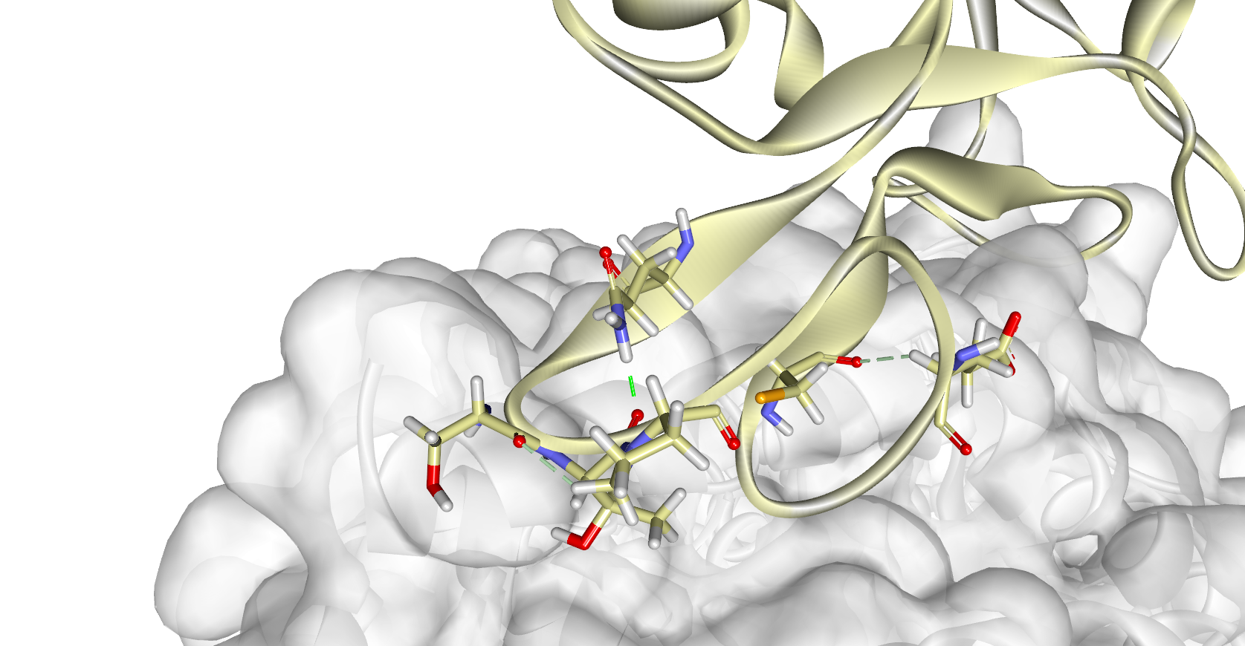
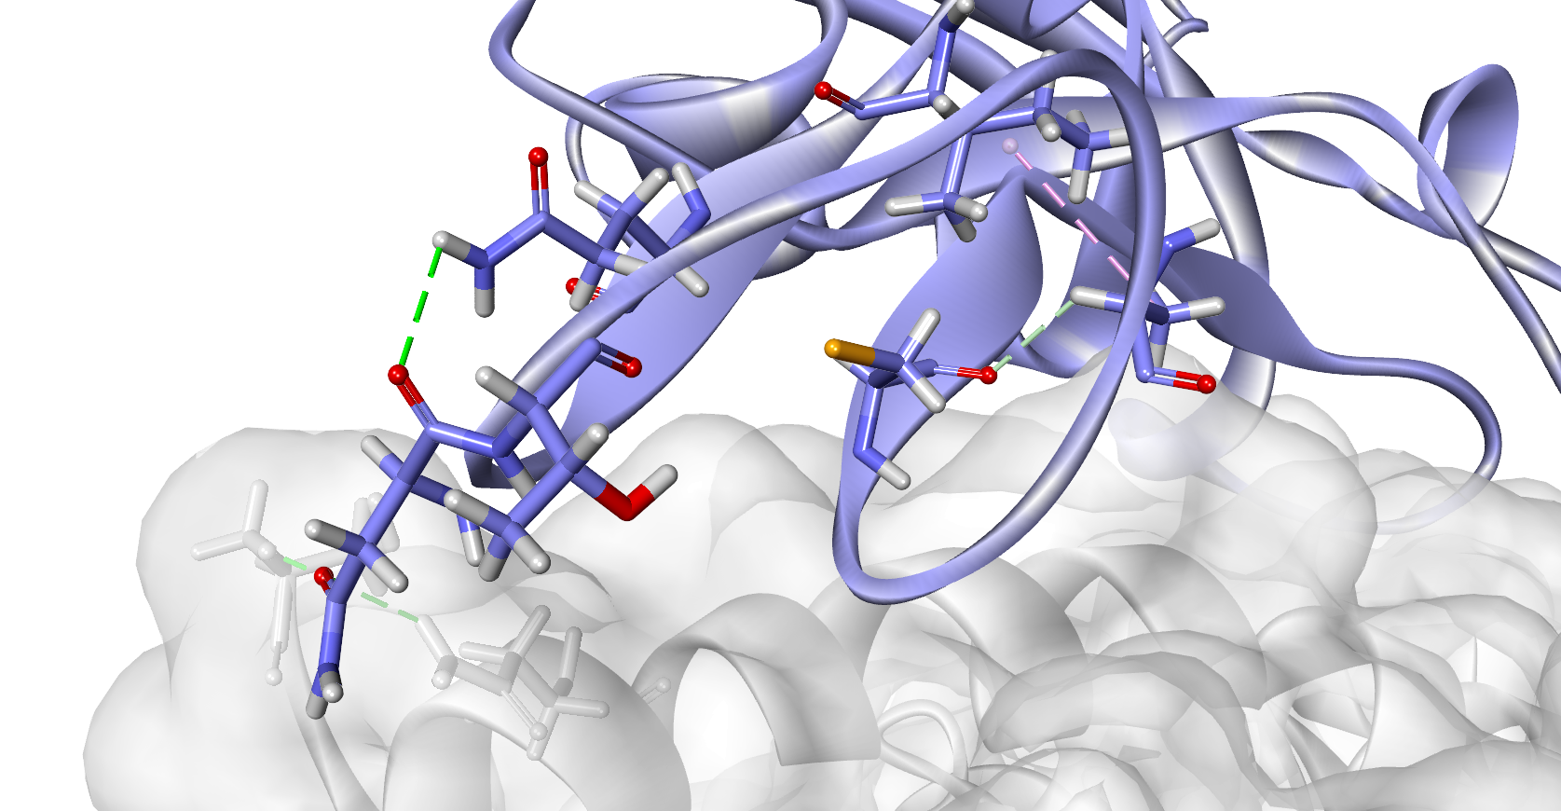
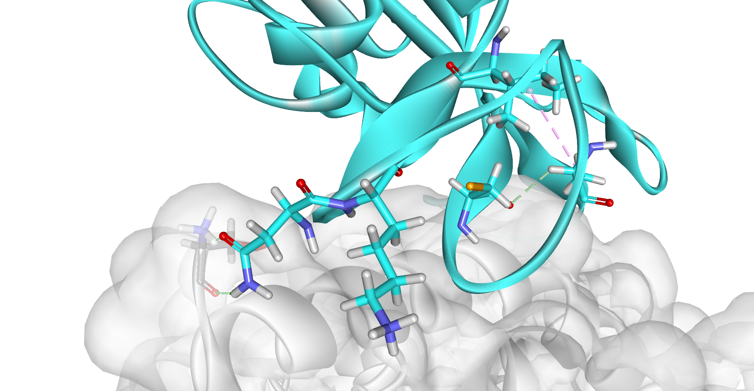
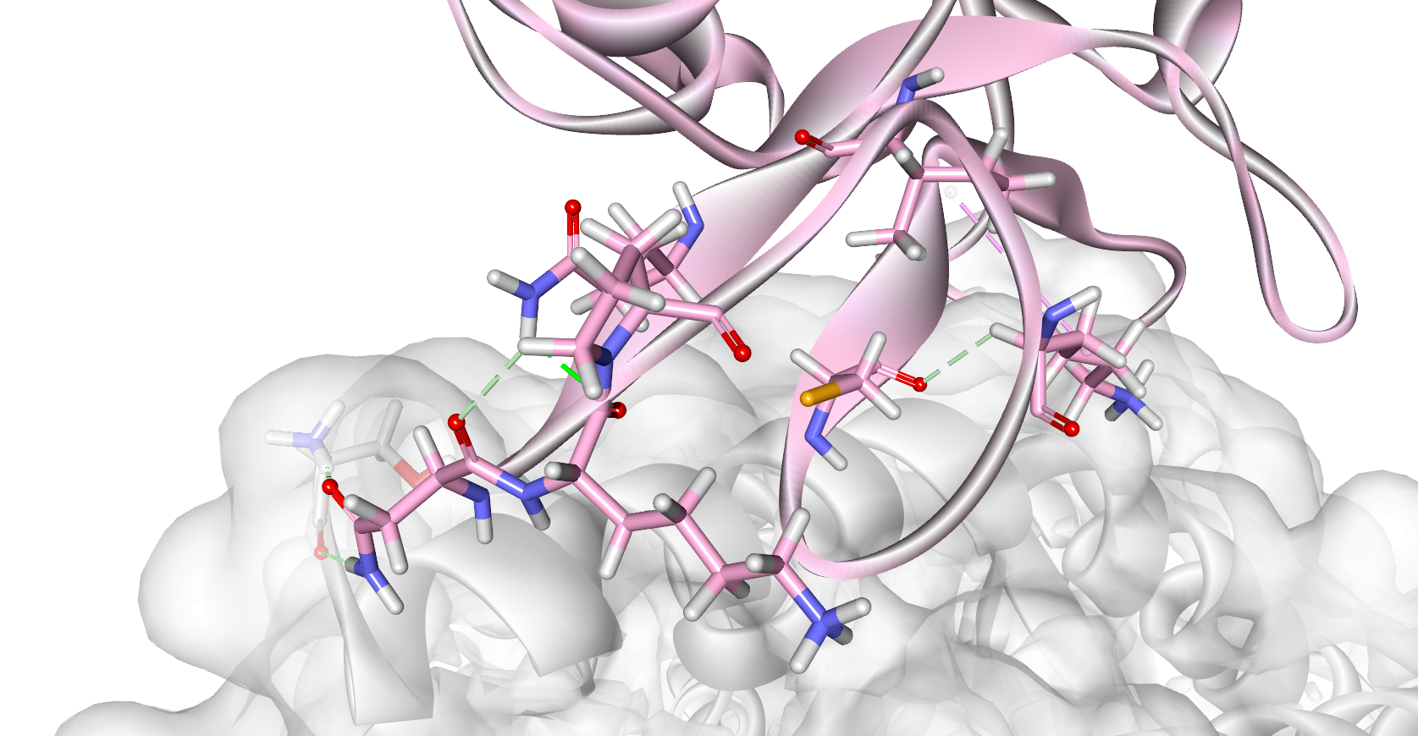
Binding Pattern Analysis of SARS-CoV-2 RBD-hACE2 Complex
Wild-type RBD-hACE2
S477N-E484A RBD-hACE2
BFE: -41.89 kcal/mol
H-bond:
T478-Q474
I472
BFE: -65.34 kcal/mol
H-bond:
N477-Q474, N477-S19
Hydrophobic:
A484-I472
Q474
Q474
C488
A484
S19
C488
E484
T478
S477
T478-P479
Q24
N477
S477N-T478K-E484A RBD-hACE2
S477N-T478K-E484K RBD-hACE2
BFE: -63.05 kcal/mol
H-bond:
N477-S19
Hydrophobic:
A484-I472
I472
BFE: -61.78 kcal/mol
H-bond:
N477-S19, T478-Q474
Hydrophobic:
K484-I472
I472
Q474
A484
S19
P479
C488
C488
K484
S19
N477
N477
K478
K478
Notes:
These are the binding pattern of wild-type RBD compared to three mutated RBD that have the lowest binding free energy.
the mutation on 484 position (both E to A/K) forms hydrophobic interaction with isoleucine 472, to stabilize the RBD structure.
The asparagine (N) in the N477-A484 complex forms H-bond with S19 and Q24 of ace2, while asparagine in other complexes only binds to S19 position.
It can be indicated that the asparagine substitution not only increases the stability of the RBD, but also has some great impact on the interactions between SARS-CoV-2 RBD and hACE2 protein.

Slide 16
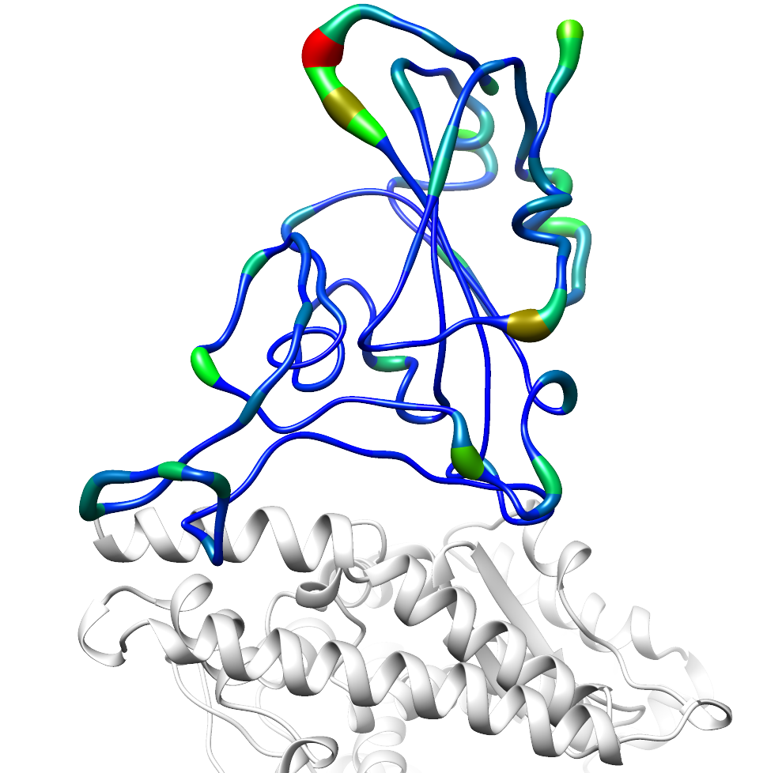
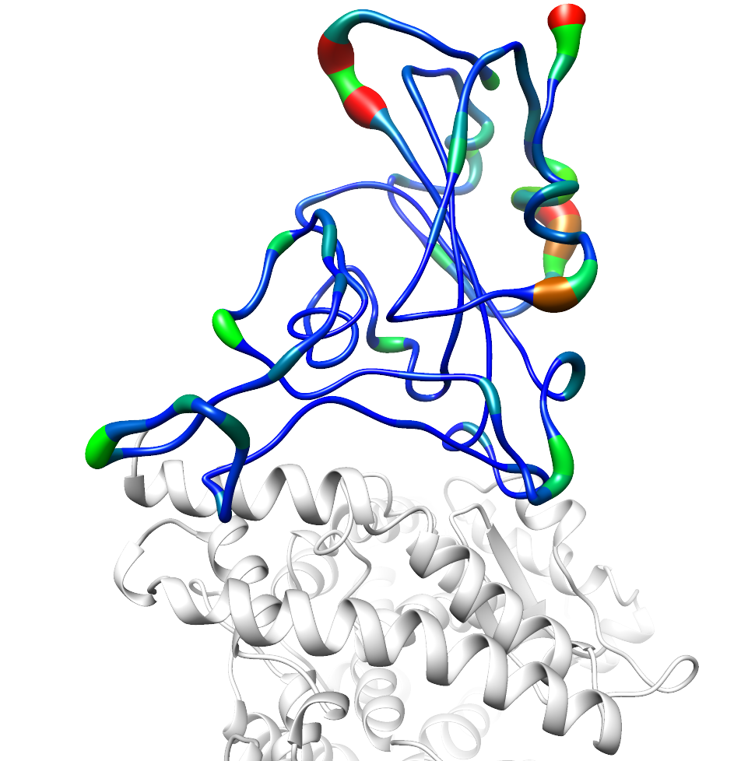
Dynamics of Mutated RBD on the Interaction with hACE2
S477N-E484A RBD-hACE2
S477N-T478K-E484A RBD-hACE2
N449-Y450
N449-Y450
K478
K444-V445
K444-V445
Low
High
Low
High
449
449
477-484
477-484
494-500
494-500
Notes:
These are sausage representations of two complexes that have the lowest dG compared to the RMSF plots to examine their dynamics.
The thickness of the tubes relates to the flexibility of the structure.
You can see that these two complexes have a similar deviation in terms of protein stability, but some region in the S477N-E484A has slightly lower fluctuation compared to the wild-type.

Slide 17
Conclusions
The S477N and E484A mutations decrease structural fluctuation (RMSF) of the loop on SARS-CoV-2 RBD, while the T478K and E484K mutations slightly enhance residual fluctuation.
The S477N-E484A complex has the lowest binding free energy, following by the S477N-T478K-E484A mutation, which appears in the omicron variant.
From the MM/GBSA calculation (energy decomposition), the S477N mutation plays a key role in the RBD-hACE2 attachment.
Future Plan
Perform MM/PBSA calculations to compare with the current results.
(Optional) Calculate structural feature importance.

Slide 18
Acknowledgement
Assoc. Prof. Dr. Nuttee Suree (Advisor)
Assoc. Prof. Dr. Lalida Shank and Assist. Prof. Dr. Panchika Prangkio (Co-advisor)
Member of the Center for AIDS Drug Discovery (CADD)
Interdisciplinary Program in Biotechnology, Graduate School, Chiang Mai University
Division of Biochemistry and Biochemical Innovation, Department of Chemistry, Faculty of Science, Chiang Mai University

Slide 19

Thank you for your attention

Slide 20
References
Amaral, M., Kokh, D. B., Bomke, J., Wegener, A., Buchstaller, H. P., Eggenweiler, H. M., Matias, P., Sirrenberg, C., Wade, R. C., & Frech, M. (2017). Protein conformational flexibility modulates kinetics and thermodynamics of drug binding. Nature Communications, 8(1). https://doi.org/10.1038/s41467-017-02258-w
Capriotti, E., Fariselli, P., Rossi, I., & Casadio, R. (2008). A three-state prediction of single point mutations on protein stability changes. BMC Bioinformatics, 9(SUPPL. 2), 1–9. https://doi.org/10.1186/1471-2105-9-S2-S6
Choi, S. B., Yap, B. K., Choong, Y. S., & Wahab, H. (2018). Molecular dynamics simulations in drug discovery. Encyclopedia of Bioinformatics and Computational Biology: ABC of Bioinformatics, 1–3, 652–665. https://doi.org/10.1016/B978-0-12-809633-8.20154-4
Decherchi, S., & Cavalli, A. (2020). Thermodynamics and Kinetics of Drug-Target Binding by Molecular Simulation. Chemical Reviews, 120(23), 12788–12833. https://doi.org/10.1021/acs.chemrev.0c00534
Fuglebakk, E., Echave, J., & Reuter, N. (2012). Measuring and comparing structural fluctuation patterns in large protein datasets. Bioinformatics, 28(19), 2431–2440. https://doi.org/10.1093/bioinformatics/bts445
Genheden, S., & Ryde, U. (2015). The MM/PBSA and MM/GBSA methods to estimate ligand-binding affinities. Expert Opinion on Drug Discovery, 10(5), 449–461. https://doi.org/10.1517/17460441.2015.1032936
Gorbalenya, A. E., Baker, S. C., Baric, R. S., de Groot, R. J., Drosten, C., Gulyaeva, A. A., Haagmans, B. L., Lauber, C., Leontovich, A. M., Neuman, B. W., Penzar, D., Perlman, S., Poon, L. L. M., Samborskiy, D. V., Sidorov, I. A., Sola, I., & Ziebuhr, J. (2020). The species Severe acute respiratory syndrome-related coronavirus: classifying 2019-nCoV and naming it SARS-CoV-2. Nature Microbiology, 5(4), 536–544. https://doi.org/10.1038/s41564-020-0695-z
Gross, L. Z. F., Sacerdoti, M., Piiper, A., Zeuzem, S., Leroux, A. E., & Biondi, R. M. (2020). ACE2, the Receptor that Enables Infection by SARS-CoV-2: Biochemistry, Structure, Allostery and Evaluation of the Potential Development of ACE2 Modulators. ChemMedChem, 15(18), 1682–1690. https://doi.org/10.1002/cmdc.202000368

Slide 21
References
Hollingsworth, S. A., & Dror, R. O. (2018). Molecular Dynamics Simulation for All. Neuron, 99(6), 1129–1143. https://doi.org/10.1016/j.neuron.2018.08.011
Horx, P., & Geyer, A. (2020). Defining the mobility range of a hingetype connection using molecular dynamics and metadynamics. PLoS ONE, 15(4), 1–18. https://doi.org/10.1371/journal.pone.0230962
Hospital, A., Goñi, J. R., Orozco, M., & Gelpí, J. L. (2015). Molecular dynamics simulations: advances and applications. Advances and Applications in Bioinformatics and Chemistry : AABC, 8, 37–47. https://doi.org/10.2147/AABC.S70333
Jost Lopez, A., Quoika, P. K., Linke, M., Hummer, G., & Köfinger, J. (2020). Quantifying Protein-Protein Interactions in Molecular Simulations. Journal of Physical Chemistry B, 124(23), 4673–4685. https://doi.org/10.1021/acs.jpcb.9b11802
Khan., A., Wei, D. Q., Kousar, K., Abubaker, J., Ahmad, S., Ali, J., Al-Mulla, F., Ali, S. S., Nizam-Uddin, N., Mohammad Sayaf, A., & Mohammad, A. (2021). Preliminary Structural Data Revealed That the SARS-CoV-2 B.1.617 Variant’s RBD Binds to ACE2 Receptor Stronger Than the Wild Type to Enhance the Infectivity. ChemBioChem, 22(16), 2641–2649. https://doi.org/10.1002/cbic.202100191
Lan, J., Ge, J., Yu, J., Shan, S., Zhou, H., Fan, S., Zhang, Q., Shi, X., Wang, Q., Zhang, L., & Wang, X. (2020). Structure of the SARS-CoV-2 spike receptor-binding domain bound to the ACE2 receptor. Nature, 581(7807), 215–220. https://doi.org/10.1038/s41586-020-2180-5
Lebeau, G., Vagner, D., Frumence, É., Ah-Pine, F., Guillot, X., Nobécourt, E., Raffray, L., & Gasque, P. (2020). Deciphering SARS-CoV-2 virologic and immunologic features. International Journal of Molecular Sciences, 21(16), 1–40. https://doi.org/10.3390/ijms21165932
Muratov, E. N., Amaro, R., Andrade, C. H., Brown, N., Ekins, S., Fourches, D., Isayev, O., Kozakov, D., Medina-Franco, J. L., Merz, K. M., Oprea, T. I., Poroikov, V., Schneider, G., Todd, M. H., Varnek, A., Winkler, D. A., Zakharov, A. V., Cherkasov, A., & Tropsha, A. (2021). A critical overview of computational approaches employed for COVID-19 drug discovery. Chemical Society Reviews, 50(16), 9121–9151. https://doi.org/10.1039/d0cs01065k

Slide 22
References
Sun, J., Liu, M., & Yang, N. (2021). Insight into the origin of SARS-CoV-2 through structural analysis of receptor recognition: a molecular simulation study. RSC Advances, 11(15), 8718–8729. https://doi.org/10.1039/d1ra00127b
V’kovski, P., Kratzel, A., Steiner, S., Stalder, H., & Thiel, V. (2021). Coronavirus biology and replication: implications for SARS-CoV-2. Nature Reviews Microbiology, 19(3), 155–170. https://doi.org/10.1038/s41579-020-00468-6
Wang, C., Greene, D., Xiao, L., Qi, R., & Luo, R. (2018). Recent developments and applications of the MMPBSA method. Frontiers in Molecular Biosciences, 4(JAN), 1–18. https://doi.org/10.3389/fmolb.2017.00087
Wrapp, D., Wang, N., Corbett, K. S., Goldsmith, J. A., Hsieh, C. L., Abiona, O., Graham, B. S., & McLellan, J. S. (2020). Cryo-EM structure of the 2019-nCoV spike in the prefusion conformation. Science, 367(6483), 1260–1263. https://doi.org/10.1126/science.aax0902
Zheng, J. (2020). SARS-coV-2: An emerging coronavirus that causes a global threat. International Journal of Biological Sciences, 16(10), 1678–1685. https://doi.org/10.7150/ijbs.45053
Zhou, P., Yang, X. Lou, Wang, X. G., Hu, B., Zhang, L., Zhang, W., Si, H. R., Zhu, Y., Li, B., Huang, C. L., Chen, H. D., Chen, J., Luo, Y., Guo, H., Jiang, R. Di, Liu, M. Q., Chen, Y., Shen, X. R., Wang, X., … Shi, Z. L. (2020). A pneumonia outbreak associated with a new coronavirus of probable bat origin. Nature, 579(7798), 270–273. https://doi.org/10.1038/s41586-020-2012-7
Zhou, W., Xu, C., Wang, P., Luo, M., Xu, Z., Cheng, R., Jin, X., Guo, Y., Xue, G., Juan, L., Anashkina, A. A., Nie, H., & Jiang, Q. (2021). N439K Variant in Spike Protein Alter the Infection Efficiency and Antigenicity of SARS-CoV-2 Based on Molecular Dynamics Simulation. Frontiers in Cell and Developmental Biology, 9(August), 1–11. https://doi.org/10.3389/fcell.2021.697035

